Slide 1
Cryptsetup- Javacard
Hitesh Lilhare - 476356
Urvekumar C Shah-476355

Slide 2
Agenda
Issues & Code Improvement
Profiling- APDU
Profiling- JCProfilier
Profiling – Manual

Slide 3
Issues & Code Improvement-I
States with consecutive values
STATE_IDLE = (short)0x4CCC;
STATE_KEY_ESTABILISHED = (short)0x5555;
STATE_AUTHENTICATED = (short)0x2AAA;
Notes:
The applet can be in 3 states STATE_IDLE 0 STATE_KEY_ESTABILISHED 1 STATE_AUTHENTICATED 2

Slide 4
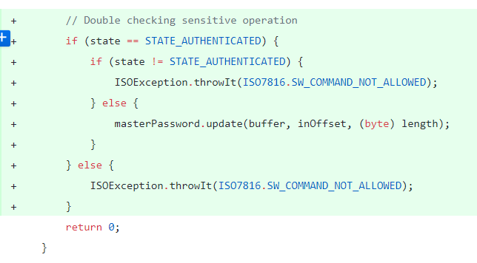
Issues & Code Improvement-II
Single time state value validation
Notes:
before allowing the user to perform sensitive operation

Slide 5
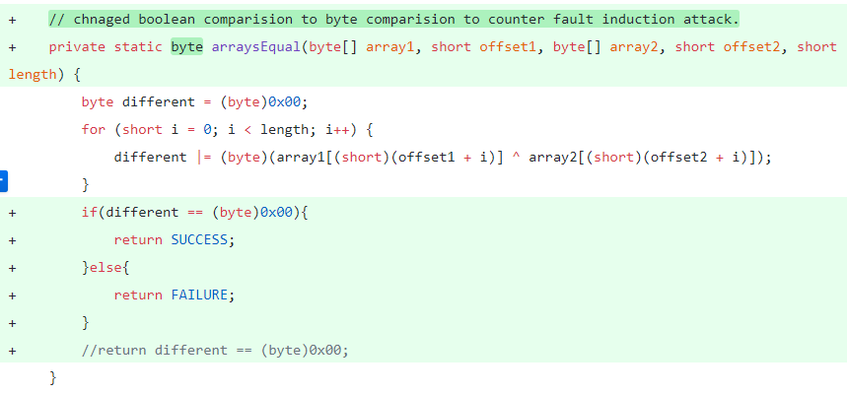
Issues & Code Improvement-III
Boolean comparison based operation
Notes:
In applet code, in arraysEqual() and verify() method, the operation is performed on the boolean comparison which is susceptible to fault induction attack.

Slide 6
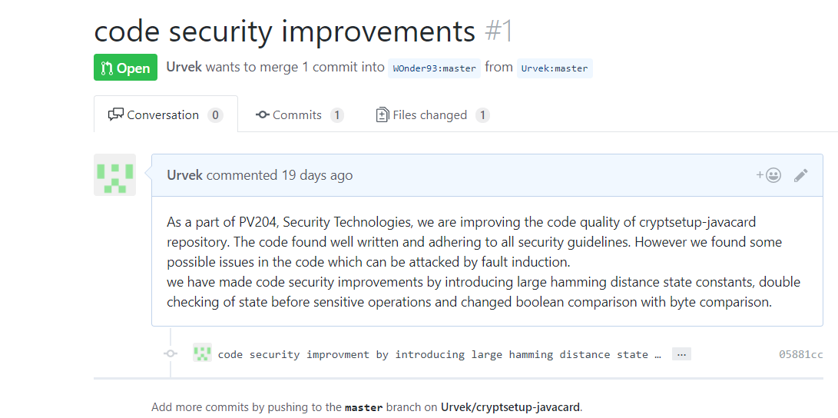
Outcome of the exercise

Slide 7
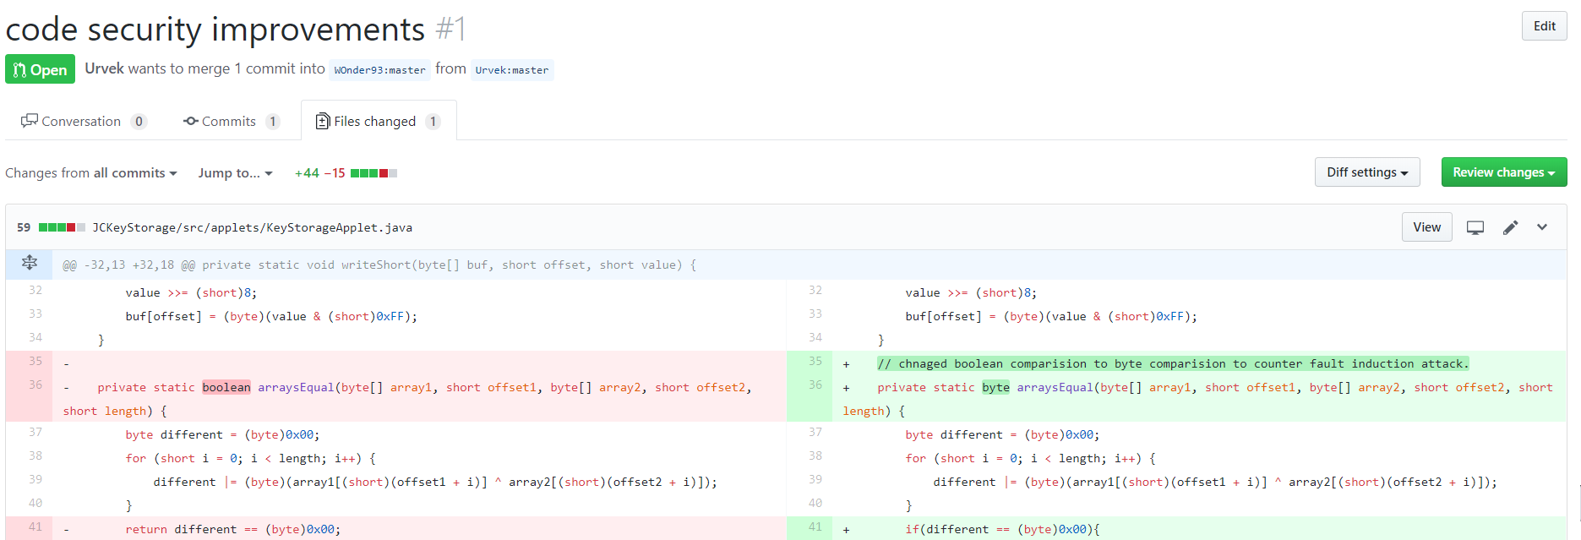

Slide 8
Profiling- APDU
Sr. No | Command | Avg Time (ns)
1 | INS_GETPUBKEY (0x50) | 26619862
2 | INS_HANDSHAKE (0x51) | 1811472034
3 | INS_COMMAND (0x52) + CMD_AUTH (0x00) | 158243573
4 | INS_COMMAND (0x52) + CMD_CHANGEPW (0x01) | 174816345
5 | INS_COMMAND (0x52) + CMD_GENKEY (0x02) | 186454739
6 | INS_COMMAND (0x52) + CMD_STOREKEY (0x03) | 219109635
7 | INS_COMMAND (0x52) + CMD_LOADKEY (0x04) | 198403275
8 | INS_COMMAND (0x52) + CMD_DELKEY (0x05) | 344636378
9 | INS_COMMAND (0x52) + CMD_CLOSE (0x06) | 149424505

Slide 9
Profiling- JCProfiler
Successfully generated TRAPS
Integrate with Applet code
Load Applet to card
Preparation of Client Application

Slide 10
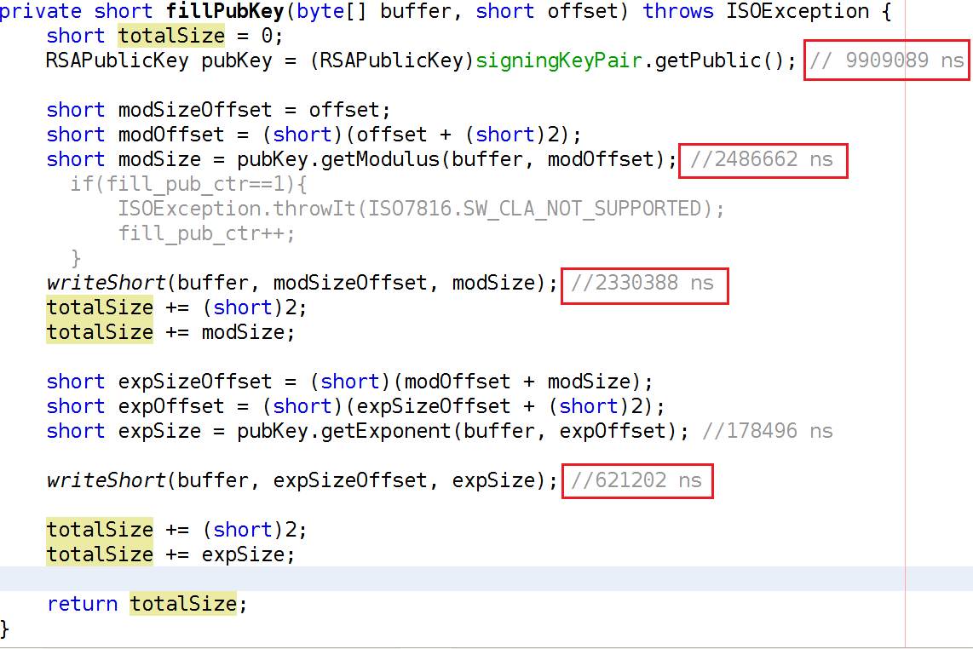
Profiling- Manual-I

Slide 11
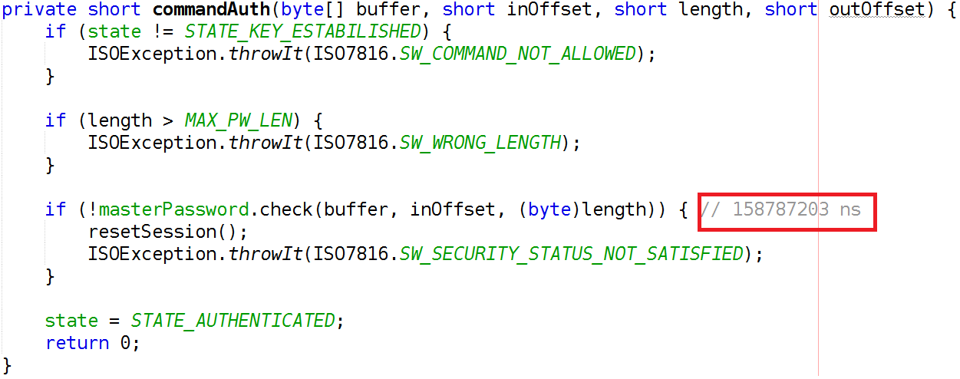
Profiling- Manual-II

Slide 12
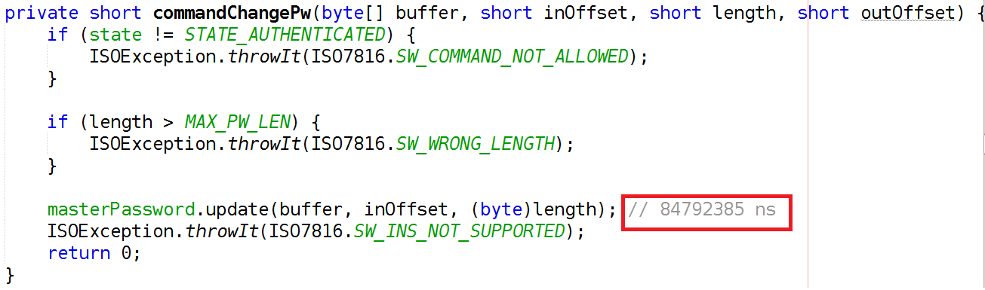
Profiling- Manual-III

Slide 13
Profiling- Manual-IV

Slide 14
Thank You for your attention.

